Slide 1
Learnable Nonlinear Circuitry in Printed Neuromorphic Computing System
Master Thesis
Zhidong Yang, Supervisor: Haibin Zhao
Notes:
thanks for your introduction

Slide 2
Background
Learnable Nonlinear Circuitry in Printed Neuromorphics
Introduction of printed Neuromorphics
Neuromorphic Computing
inspired by the workings of the brain, neural network(NN)
simple primitive operations: weighted-sum & activation function
high ability to approximate desired functionalities
Printed electronics (PE)
Flexibility:High level customization due to additive manufacturing
nontoxicity, ultra low-cost…
Notes:
This work is based on printed Neuromorphics. Printed Neuromorphics(use printed electronics to
Implement Neuromorphic Computing), so how to
,

Slide 3
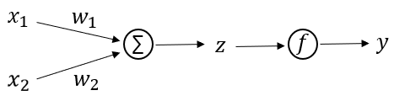
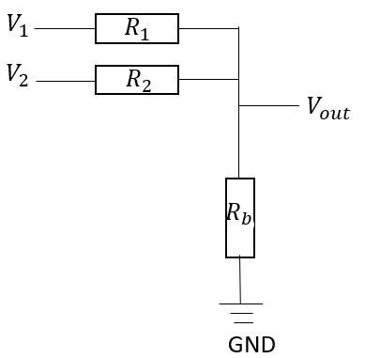

Background
Learnable Nonlinear Circuitry in Printed Neuromorphics
weigthed-sum
Crossbar work as weighted-sum
weighted-sum: $z = \sum_{i}{w_{i}x_{i}}$
crossbar : $V_{out} =\sum_{i}{\frac{g_{i}^{}}{G}V_{i}}$
where $g_{i}^{}=\frac{1}{R_{i}^{}}$, and $G=\sum_{i}{g_{i}^{}}+g_{b}^{}$
crossbar for weighted-sum

Slide 4
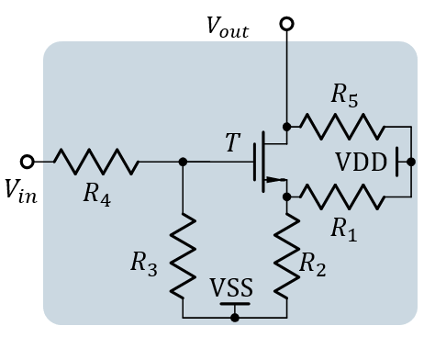
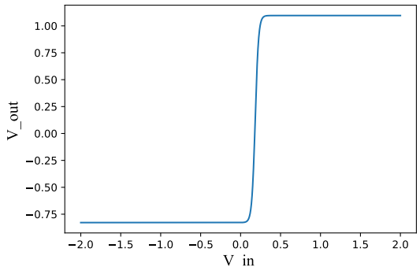

Background
Learnable Nonlinear Circuitry in Printed Neuromorphics
Activation function
Nonlinear Circuit as activation function
$V_{out}={ptanh}_{η}\left(V_{z}\right)=η_{1}+η_{2}⋅\tanh\left(\left(V_{in}−η_{3}\right)⋅η_{4}\right)$
where $η=\left[η_{1},η_{2},η_{3},η_{4}\right]$ is the auxiliary parameter, which
describe the form of this characteristic curve.

Slide 5
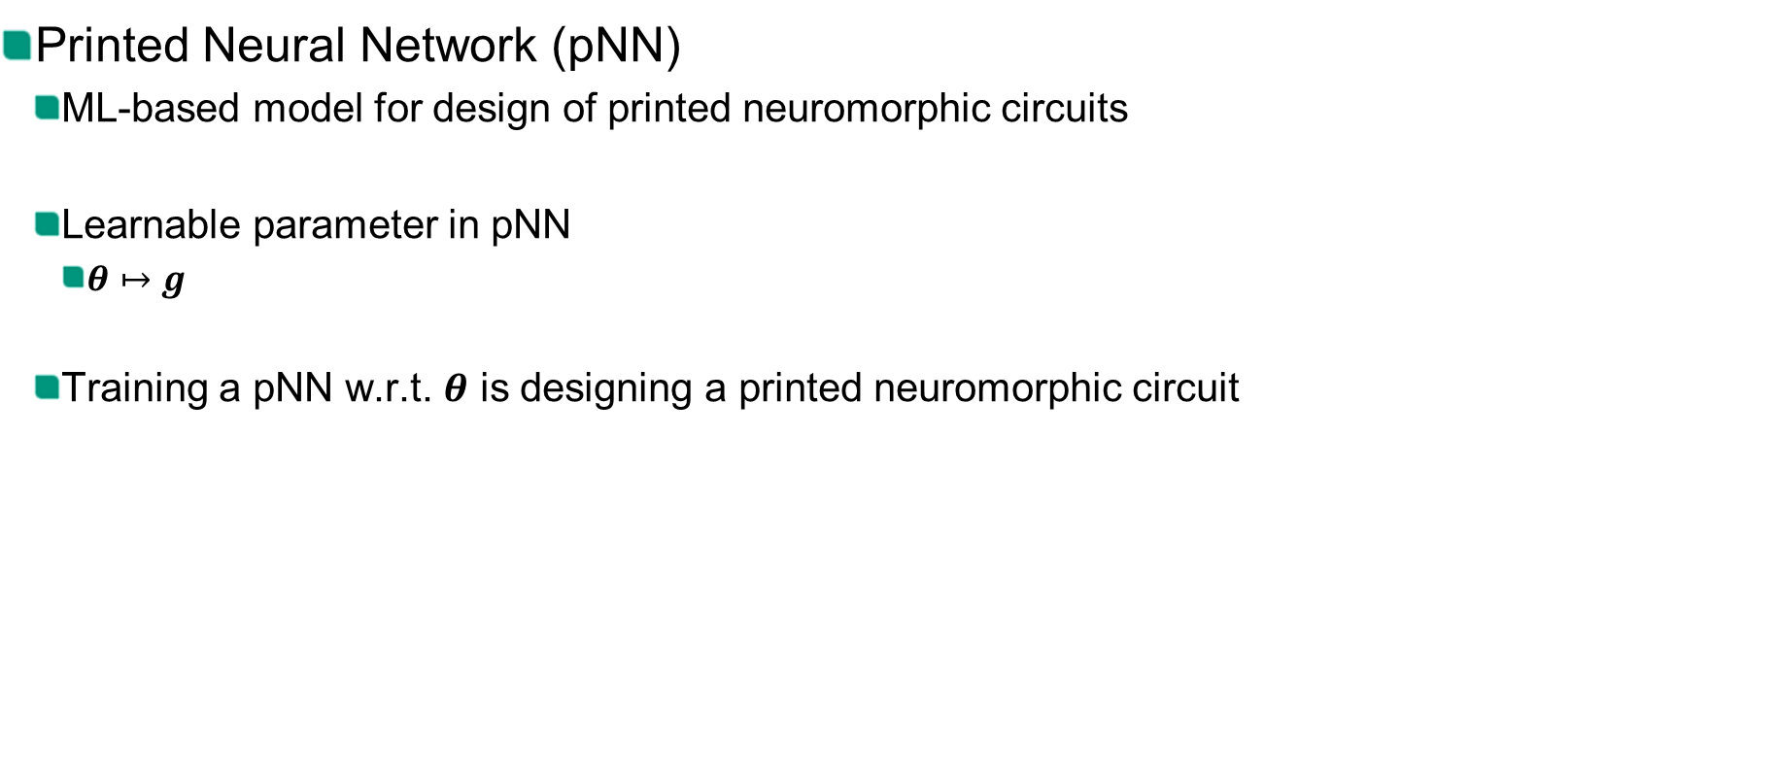
Background
Learnable Nonlinear Circuitry in Printed Neuromorphics
Printed Neural Network (pNN)
Printed Neural Network (pNN)
ML-based model for design of printed neuromorphic circuits
Learnable parameter in pNN
$θ↦g$
Training a pNN w.r.t. $θ$ is designing a printed neuromorphic circuit
Notes:
With these circuits, To design of printed neuromorphic circuits

Slide 6
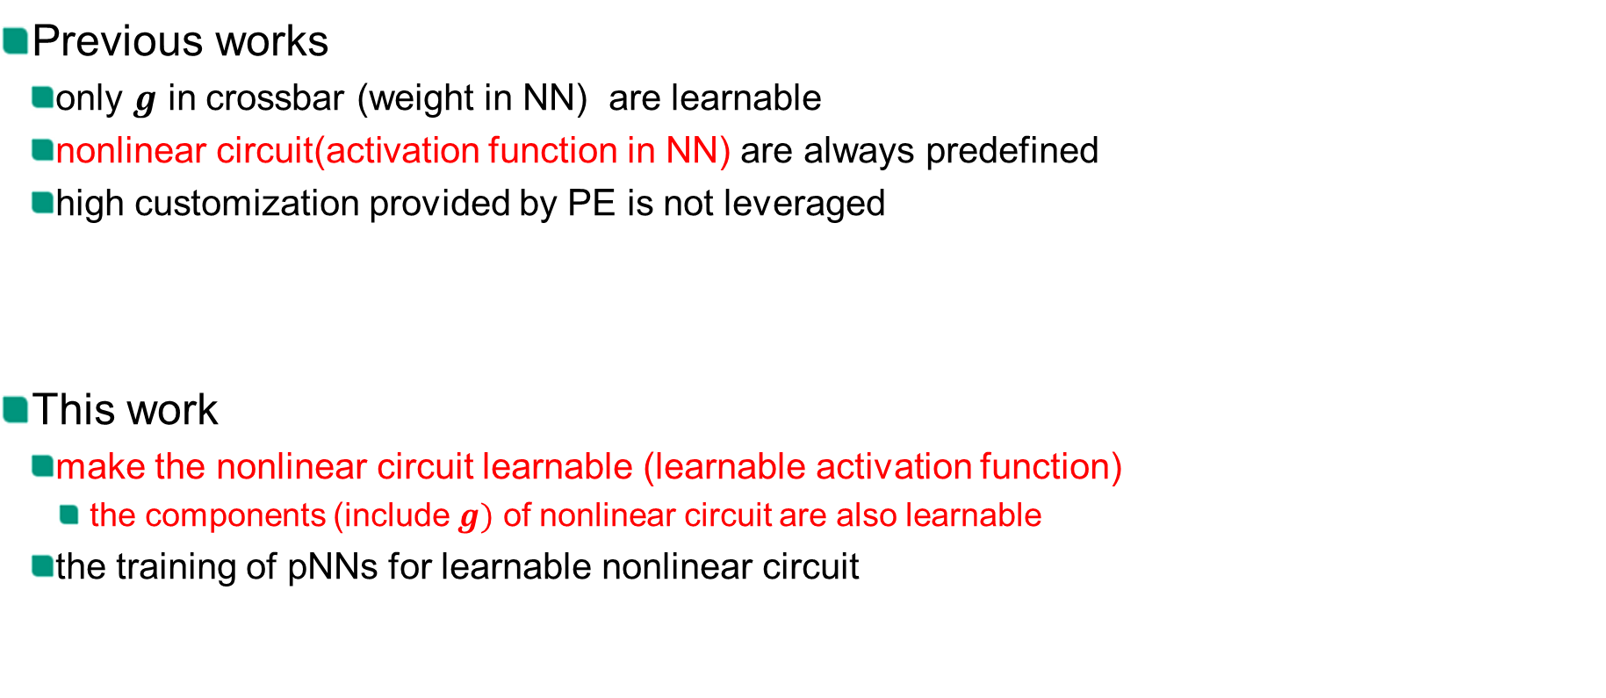
Motivation
Learnable Nonlinear Circuitry in Printed Neuromorphics
Realted work
Previous works
only $g$ in crossbar (weight in NN) are learnable
nonlinear circuit(activation function in NN) are always predefined
high customization provided by PE is not leveraged
This work
make the nonlinear circuit learnable (learnable activation function)
the components (include $g)$ of nonlinear circuit are also learnable
the training of pNNs for learnable nonlinear circuit

Slide 7
Methodology
Learnable Nonlinear Circuitry in Printed Neuromorphics
Differentiable model for learnable nonlinear circuit
NN-based Approximator
Integrate NN-based Approximator into pNNs for learnable activation function
The training for pNNs
considering variation-aware training and learning flexibility
Notes:
To do this,

Slide 8
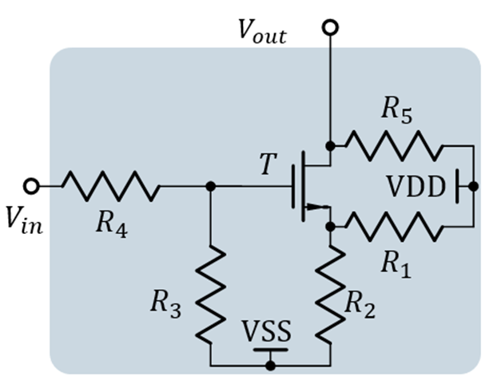
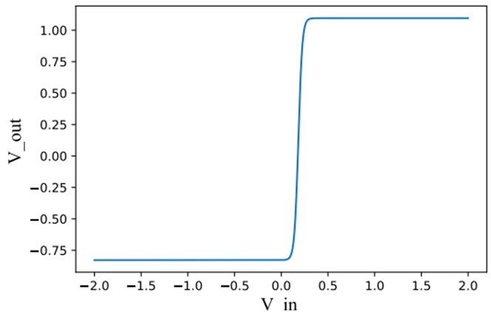

Differentiable model for learnable nonlinear circuit
Learnable Nonlinear Circuitry in Printed Neuromorphics
Parameters
Learnable: physical quantities${ p}_{}=\left[R_{1}^{},R_{2}^{},R_{3}^{},R_{4}^{},R_{5}^{},W,L\right]$
Activation function: auxiliary parameter $η=[η_{1},η_{2},η_{3},η_{4}]$
Differentiable map from${ p}_{}$to $η$ by NN
$$V_{out}=η_{1}+η_{2}⋅\tanh\left(\left(V_{in}−η_{3}\right)⋅η_{4}\right)$$
Notes:
What does model do for leanable, learnable, function of learnable

Slide 9
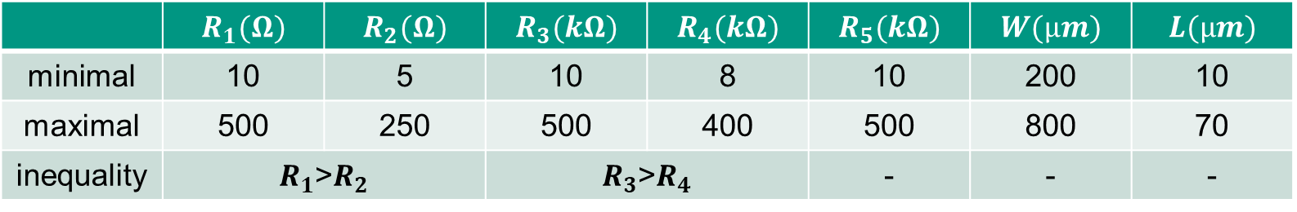
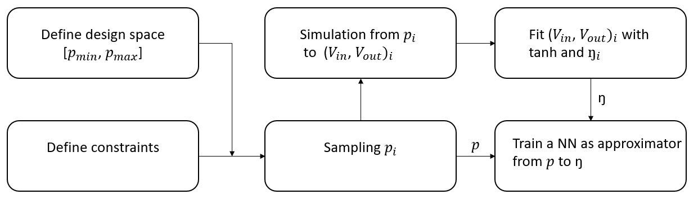
Pipeline for modeling of nonlinear circuit
Learnable Nonlinear Circuitry in Printed Neuromorphics
Design space & constraints
Draw 10000 sets of physical quantities with Quasi Monte-Carlo sampling
Pipeline for modeling of nonlinear circuit
Notes:
Sensitivity analysis

Slide 10
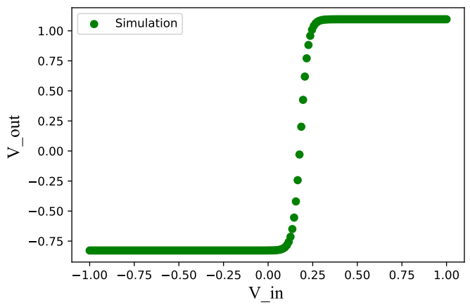
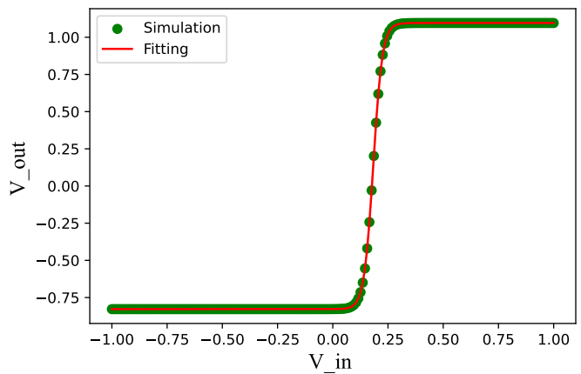

Pipeline for modeling of nonlinear circuit
Learnable Nonlinear Circuitry in Printed Neuromorphics
For each sample $p_{i}$ we do the simulation of nonlinear circuit(green points)
We fit the points ${\left(V_{in},V_{out}\right)}_{i}$ with tanh and auxiliary parameter $η_{i}(red line)$
Train a NN (NN-based Approximator) with input $p$ and output $η$
Notes:
Sensitivity analysis

Slide 11
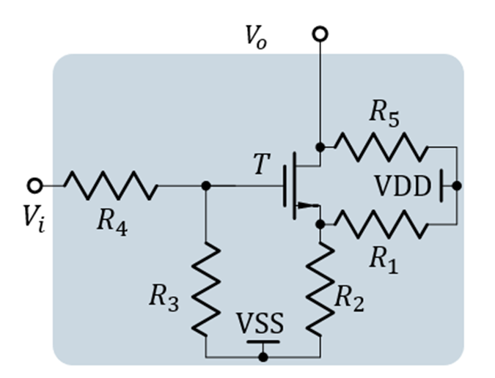
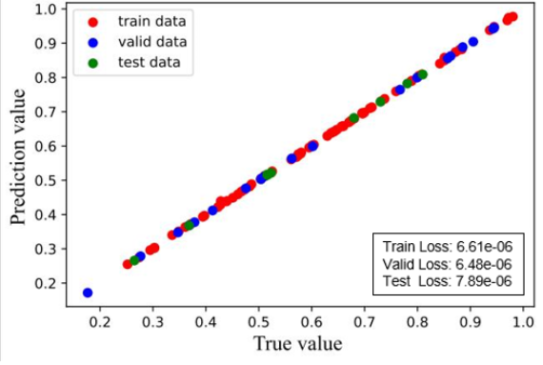
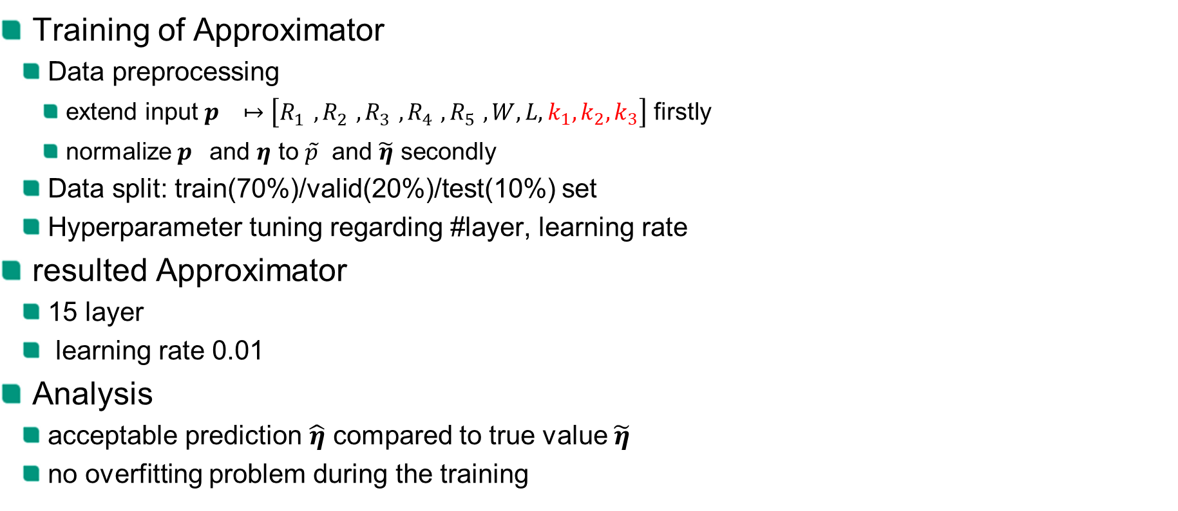
NN-based Approximator
Learnable Nonlinear Circuitry in Printed Neuromorphics
Training of Approximator
Data preprocessing
extend input $p^{}↦\left[R_{1}^{},R_{2}^{},R_{3}^{},R_{4}^{},R_{5}^{},W,L,k_{1},k_{2},k_{3}\right]$ firstly
normalize $p^{}$and $η$ to $\tilde{p}$ and $\tilde{η}$ secondly
Data split: train(70%)/valid(20%)/test(10%) set
Hyperparameter tuning regarding #layer, learning rate
resulted Approximator
15 layer
learning rate 0.01
Analysis
acceptable prediction $\hat{η}$ compared to true value $\tilde{η}$
no overfitting problem during the training
Notes:
Validloss, extend first. integration, the physical quantities are optimizable. Moreover, the variation of these physical quantities values are caused by fabrication errors, so we can also consider the fabrication error of these physical quantities in the training

Slide 12
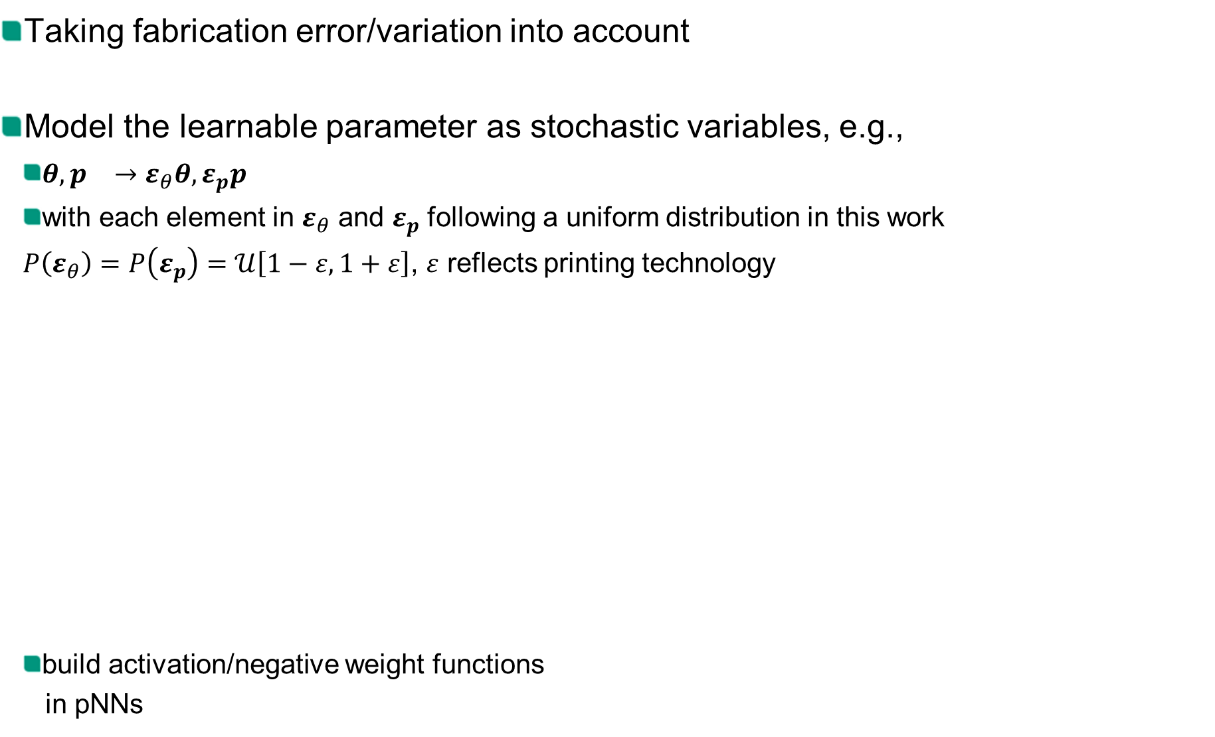
Variation-aware Training
Learnable Nonlinear Circuitry in Printed Neuromorphics
Taking fabrication error/variation into account
Model the learnable parameter as stochastic variables, e.g.,
$θ,p^{}→ε_{θ}θ,ε_{p}p^{}$
with each element in $ε_{θ}$ and $ε_{p}$ following a uniform distribution in this work
$P\left(ε_{θ}\right)=P\left(ε_{p}\right)=𝒰\left[1−ε,1+ε\right]$, $ε$ reflects printing technology
build activation/negative weight functions
in pNNs
Notes:
\epsilon
Loss. Only an approximate solution through numerical methods. Monte/Carlo approximation.
objective existence

Slide 13


Learning flexibility
Learnable Nonlinear Circuitry in Printed Neuromorphics
Different learning flexibility :
neuron-level: each neuron has independent learnable activation function
layer-level: the same learnable activation function are shared by all neurons in a layer
net-level: the same leanable activation function are shared across all neurons
Experiment for learning flexibility
13 benchmark datasets
Data split: train(60%)/valid(20%)/test(20%) set
Data preprocessing: normalization
Topology: #input – 3 – #output
Seeds ∈{0, …, 9}
.
Input
Hidden layer
Output
Notes:
To decide which learning flexibility is applied in the final experiments.

Slide 14
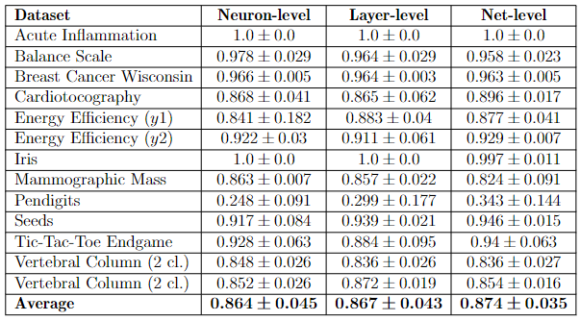
Results for learning flexibility
Learnable Nonlinear Circuitry in Printed Neuromorphics
The mean and standard deviation from valid set under different training frameworks
Despite the higher number of learnable parameters, the pNNs with neuron-level and layer-level do not perform significantly better than the pNNs with net-level
The training of pNNs with net-level is also time-saving.
.
Notes:
For different datasets, the performance of different learning flexibility can be better than else.
To demonstrate the results from different datasets more intuitively, we average the accuracies and standard deviation over all datasets as a scalar
So we use net-level in the final experients

Slide 15
Experiment for learnable nonlinear circuit
Learnable Nonlinear Circuitry in Printed Neuromorphics
-
13 benchmark datasets
Data split: train(60%)/valid(20%)/test(20%) set
Data preprocessing: normalization
topology: #input – 3 – #output
Seeds ∈{0, …, 9}
Assumption without variation (nominal training)
nonlearnable nonlinear circuit
learnable nonlinear circuit
.

Slide 16
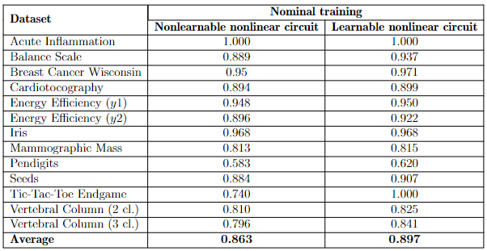
Results
Learnable Nonlinear Circuitry in Printed Neuromorphics
4.2% accuracy improvement
Notes:
We pick the best model with minimum valid loss, and evaluate it with test sets

Slide 17
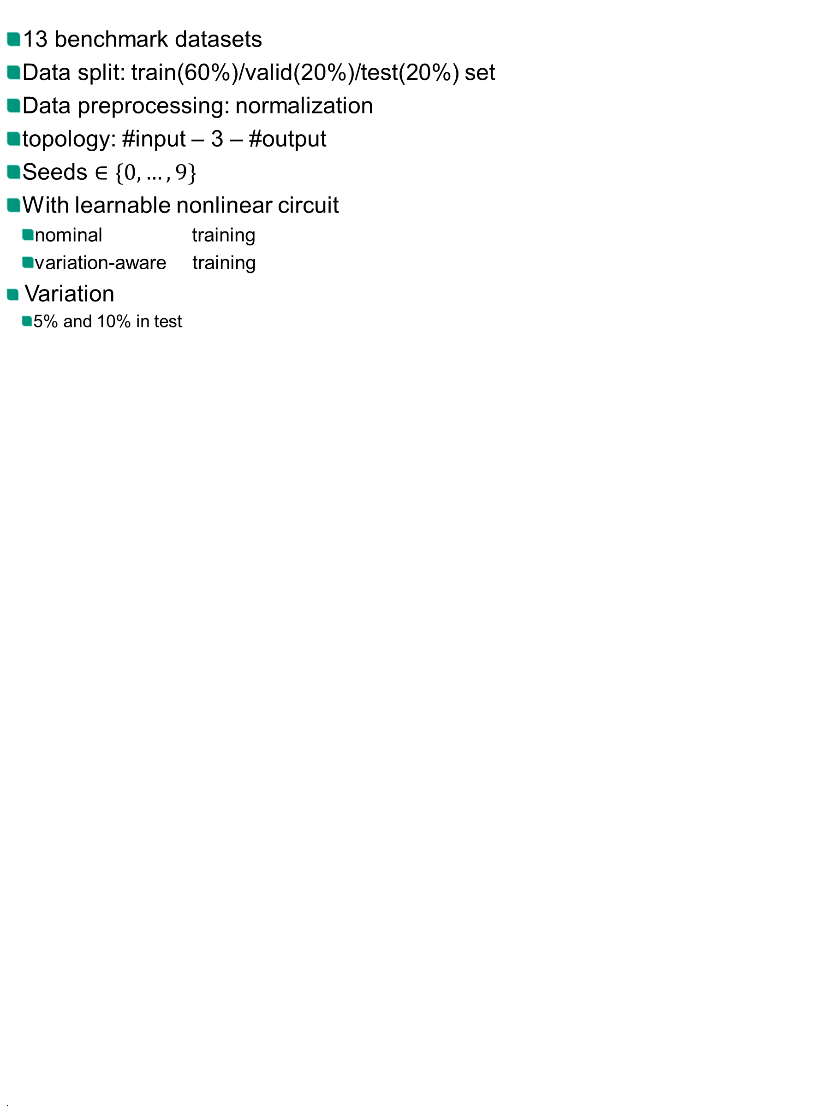
Experiment for variation-aware training
Learnable Nonlinear Circuitry in Printed Neuromorphics
-
13 benchmark datasets
Data split: train(60%)/valid(20%)/test(20%) set
Data preprocessing: normalization
topology: #input – 3 – #output
Seeds $∈\{0, …, 9\}$
With learnable nonlinear circuit
nominal training
variation-aware training
Variation
5% and 10% in test
.

Slide 18
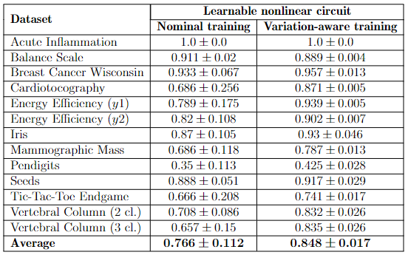
Results under 5% variation in test
Learnable Nonlinear Circuitry in Printed Neuromorphics
Analysis: compare to nominal training,
10.7% Accuracy and 84.8% Robustness(standard deviation) improvement
.

Slide 19
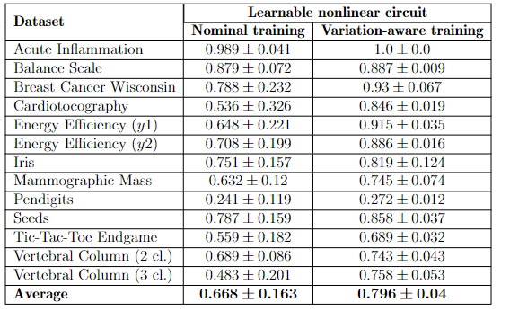
Results under 10% variation in test
Learnable Nonlinear Circuitry in Printed Neuromorphics
Analysis: compare to nominal training,
19.2% Accuracy and 75.5% Robustness improvement
.

Slide 20
Conclusion
Learnable Nonlinear Circuitry in Printed Neuromorphics
-
Enable bespoke implementation of nonlinear circuit in printed neuromorphic circuits for individual tasks
Build model(NN-based Approximator) for learnable nonlinear circuit
Integrate this Approximator into pNNs for learnable activation function
The training for pNNs: considering variation-aware training and learning flexibility
Conduct experiments and investigate
the effectiveness of learnable nonlinear circuit without variation
the effectiveness of variation-aware training with learnable nonlinear circuit
Result
4.2% accuracy improvement
10% - 20% accuracy improvement & 75% - 85% robustness improvement
.

Slide 21
Learnable Nonlinear Circuitry in Printed Neuromorphics
Thank you!
Notes:
So, this is my presentation. I'm very glad if there is any question or comment.

Slide 22
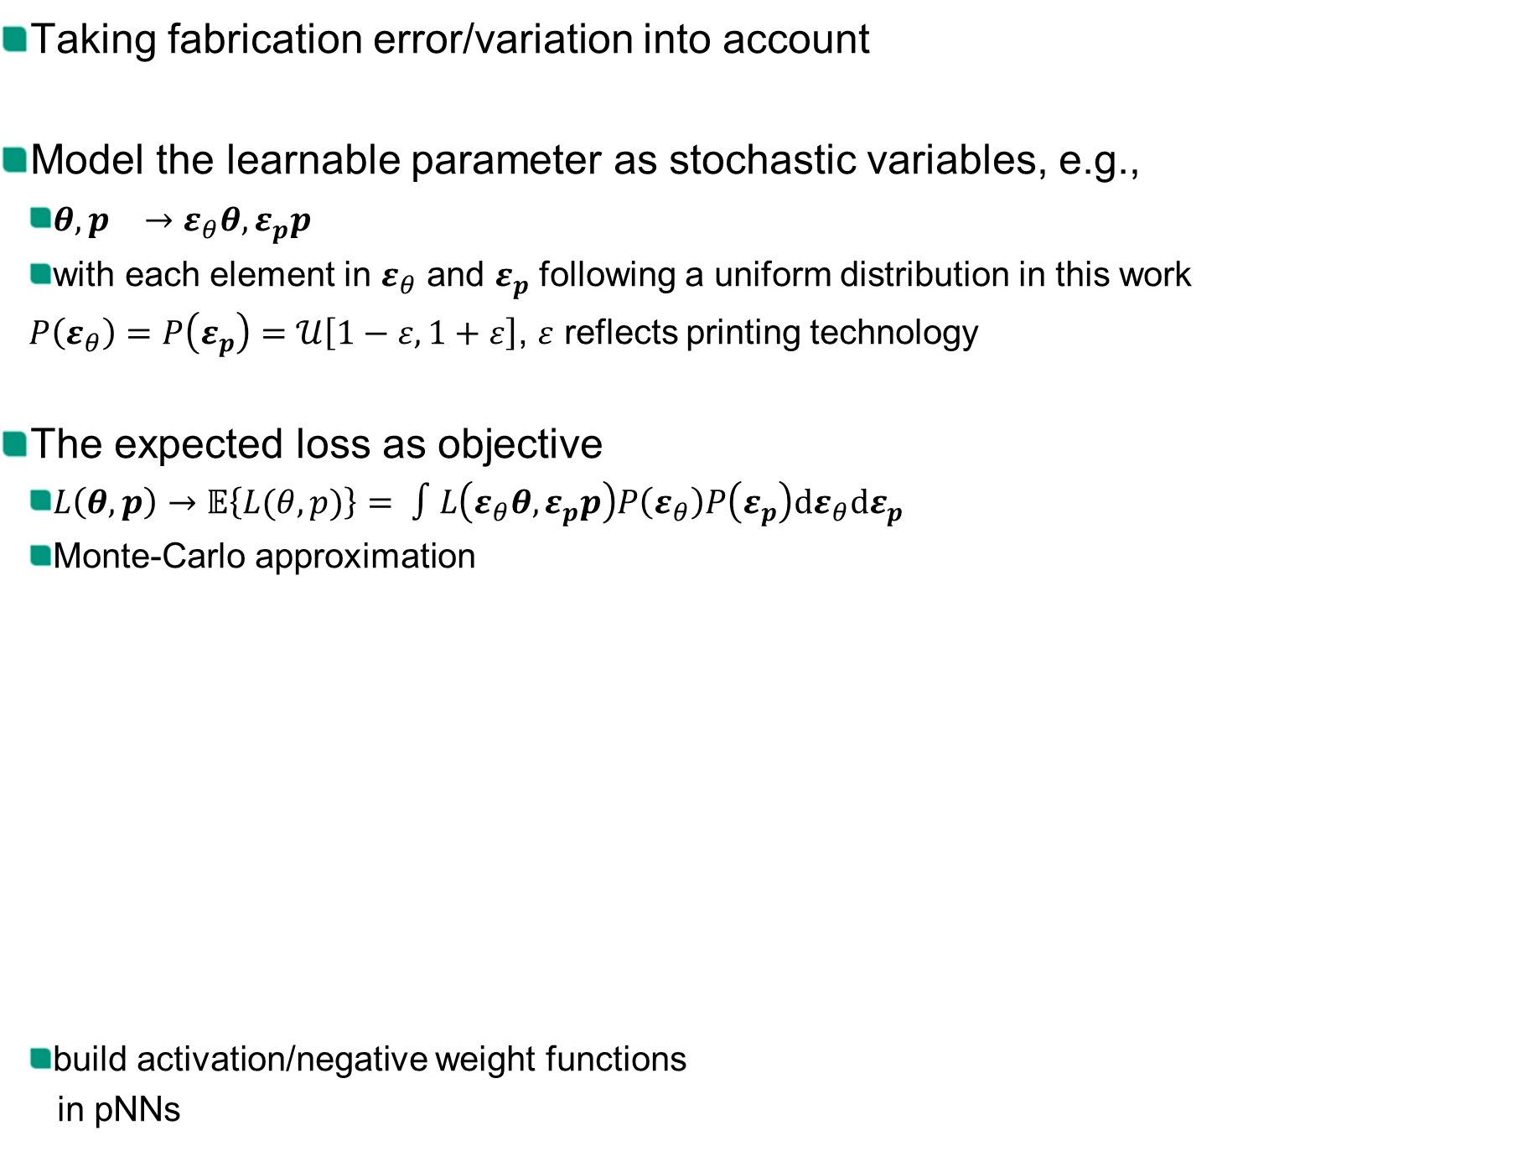
Variation-aware Training
Learnable Nonlinear Circuitry in Printed Neuromorphics
Taking fabrication error/variation into account
Model the learnable parameter as stochastic variables, e.g.,
$θ,p^{}→ε_{θ}θ,ε_{p}p^{}$
with each element in $ε_{θ}$ and $ε_{p}$ following a uniform distribution in this work
$P\left(ε_{θ}\right)=P\left(ε_{p}\right)=𝒰\left[1−ε,1+ε\right]$, $ε$ reflects printing technology
The expected loss as objective
$L\left(θ,p\right)→𝔼\left\{L(θ,p)\right\}= ∫L\left(ε_{θ}θ,ε_{p}p\right)P\left(ε_{θ}\right)P\left(ε_{p}\right)dε_{θ}dε_{p}$
Monte-Carlo approximation
build activation/negative weight functions
in pNNs
Notes:
\epsilon
Loss. Only an approximate solution through numerical methods. Monte/Carlo approximation.
objective existence

Slide 23
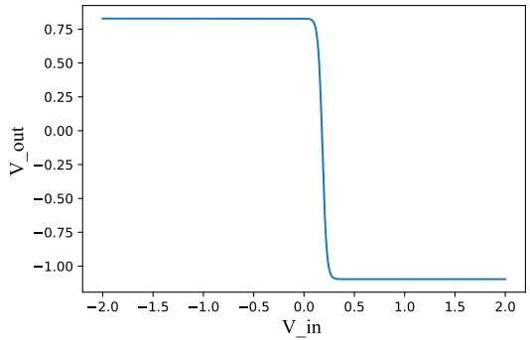











Background
Learnable Nonlinear Circuitry in Printed Neuromorphics
Hardware primitive
$$inv\left(V_{i}\right)$$
Negative Weight Circuit
recall: weighted-sum in crossbar
$\frac{g_{i}^{}}{G}V_{i}=:w_{i}V_{i}$
problem: weight (conductance) is only positive
solution: invert $V_{i}$ and still use positive conductance
$\left(−w_{i}\right)⋅V_{i}=w_{i}⋅\left(−V_{i}\right)←w_{i}⋅inv\left(V_{i}\right)$
Where $inv\left(V_{in}\right)=−\left(η_{1}+η_{2}⋅\tanh\left(\left(V_{in}−η_{3}\right)⋅η_{4}\right)\right)$
$$R_{5}$$
$$T$$
$$VDD$$
$$V_{i}$$
$$R_{4}$$
$$R_{1}$$
$$R_{3}$$
$$R_{2}$$
$$VSS$$

Slide 24
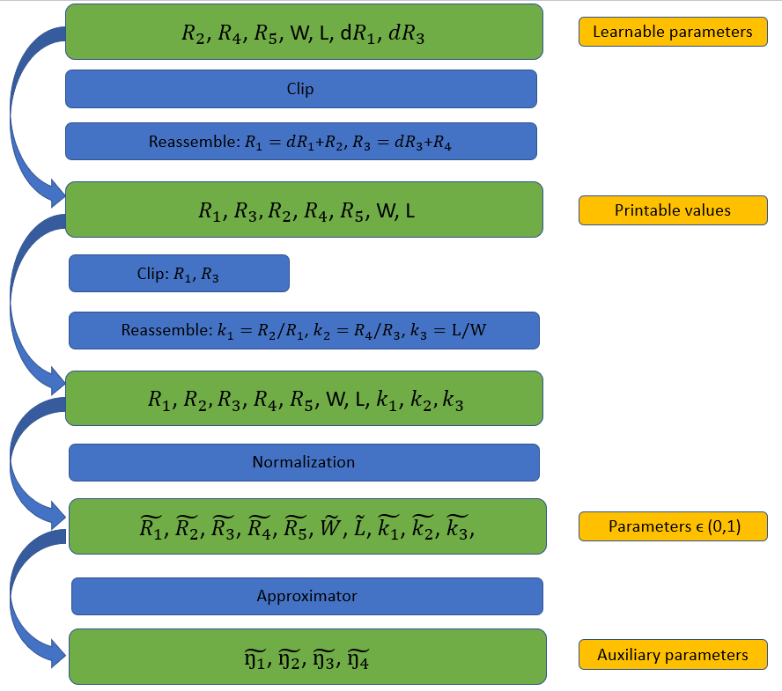
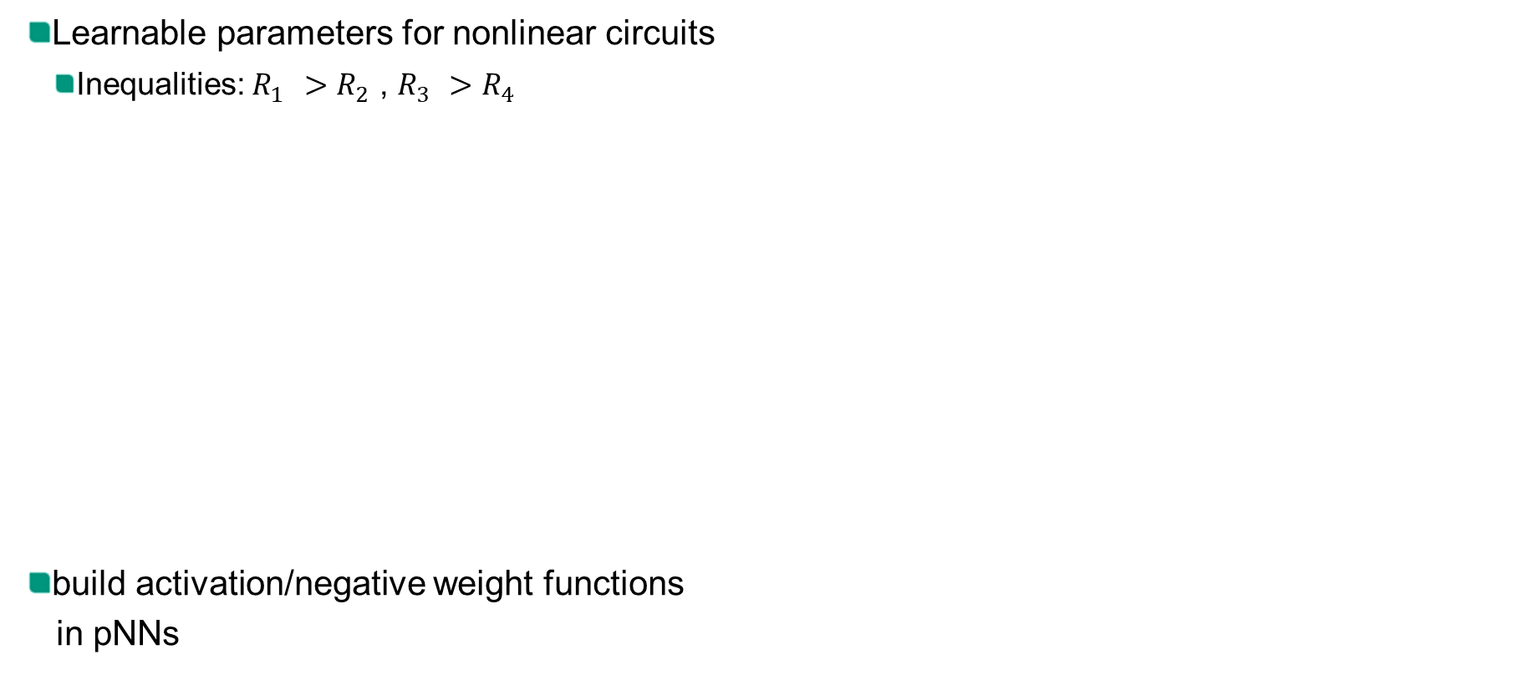
Integration of Approximator to pNNs
Learnable Nonlinear Circuitry in Printed Neuromorphics
Learnable parameters for nonlinear circuits
Inequalities: $R_{1}^{}>R_{2}^{}$, $R_{3}^{}>R_{4}^{}$
build activation/negative weight functions
in pNNs

